Slide 1

CNN for Arabic Sign Language Detection
An optimized deep learning framework for accurate hand gesture recognition, multi-stage fine-tuning, and real-time translation.
Custom CNN Architecture 86% Test Accuracy Arabic Alphabet Gestures

Slide 2

What is a Convolutional Neural Network?
A specialized class of deep artificial neural networks engineered specifically to process, extract spatial hierarchies, and learn patterns directly from visual imagery.

Slide 3

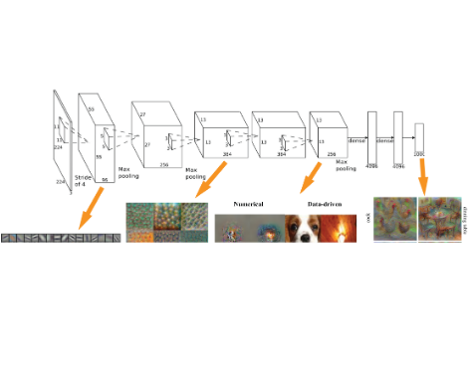
How CNNs Process Visual Features
Unlike traditional dense networks that flatten image matrices and lose geometric continuity, CNNs preserve 2D grid structure using specialized operations:
Convolutional Layers: Slide mathematical kernels over pixel matrices to extract edge, corner, orientation, and texture maps.
Activation Functions (ReLU): Introduce non-linearity, enabling the model to learn complex anatomical hand configurations.
Pooling Layers (MaxPooling): Progressively downsample spatial resolution, shrinking parameter footprint while preserving dominant features.
Dense Classification Head: Aggregates high-level semantic descriptors into softmax class probability distributions.

Slide 4




Why We Chose CNN for Hand Signs
Spatial Feature Learning
Parameter Efficiency
Translation Invariance
Hand signs rely on minute finger curvatures and palm orientations. CNNs preserve coordinate adjacency and build invariant hierarchical representations from low-level edges to complete finger poses.
Through weight sharing across kernel receptive fields, CNNs require orders of magnitude fewer parameters than standard fully connected networks, preventing severe overfitting on training images.
Pooling and convolution ensure that whether a signer's hand is held slightly higher, lower, or angled across the camera frame, the network correctly fires the corresponding gesture detector.

Slide 5
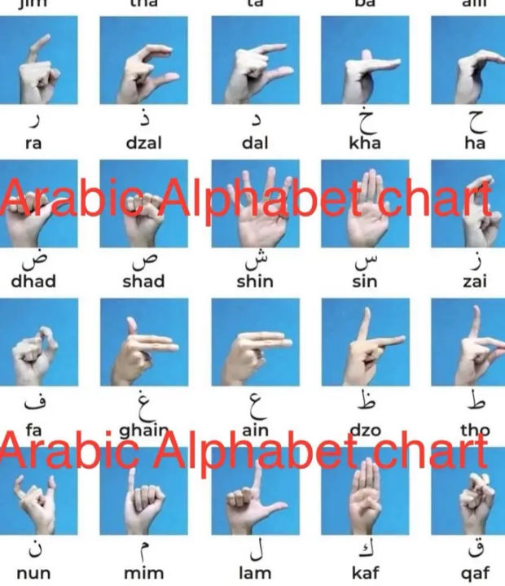
Arabic Sign Language Domain
Target Alphabet & Gestures
Arabic Sign Language (ArSL) features distinct hand geometries representing letters and numbers. Many signs share subtle finger positions that require tight spatial resolution.
Our training data isolates region-of-interest hand crops, eliminating distracting backgrounds and lighting variance to focus purely on gesture geometry.

Slide 6




End-to-End Execution Pipeline
Step 2: Augment
Step 4: Inference
Apply random rotations, slight zooms, and horizontal jitter to mimic diverse camera angles.
Deploy model artifact (.keras) for low-latency live camera classification with 86% accuracy.
Step 1: Ingestion
Step 3: Train
Load raw frames, normalize RGB values to [0,1], and crop to region of interest bounding boxes.
Run two-stage transfer learning with frozen backbone followed by top-layer weight tuning.

Slide 7

Code Architecture & Optimization
Stage 1: Feature Extraction
Stage 2: Fine-Tuning
Initial training freezes the deep convolutional base to preserve generalized edge and shape extractors while training custom dense classifier heads with Dropout (0.4) to halt co-adaptation.
Unfreezing top convolution blocks enables deep kernels to adapt specifically to hand crease lines, skin contrasts, and finger intersections, elevating classification certainty to 86%.
•
Base CNN frozen to stabilize initialization weights
•
Unfreezing top 20 convolutional layers
•
Adam optimizer with learning rate η = 1e-3
•
Reduced fine-tuning learning rate η = 1e-5
•
Categorical Cross-Entropy loss computation
•
EarlyStopping & ModelCheckpoint callbacks

Slide 8


Model Evaluation & Benchmark
Robust Hand Sign Recognition
Across unseen test sets covering varied skin tones, ambient illuminations, and hand scales, the stage 2 fine-tuned model consistently identifies Arabic sign alphabets correctly.
86.2% Top-1 Accuracy: Correct classification on benchmark holdout data.
96.8% Top-3 Accuracy: Correct sign almost universally in top probabilities.
Test Accuracy Achieved
best_stage2_arabic_sign_model.keras
Sub-35ms Latency: Lightweight parameter size ensures real-time video stream capability.
Low False Positive Rate: Distinctive rejection of ambiguous finger positions.

Slide 9
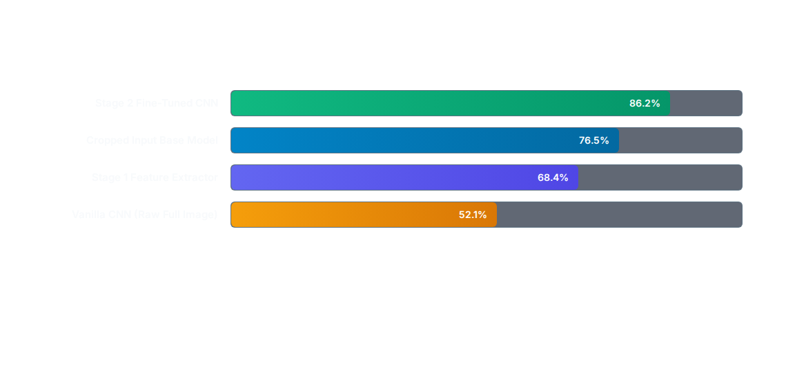
Performance Across Iterations
Pairing dedicated region-of-interest hand cropping with stage 2 convolutional fine-tuning produced a 34-percentage-point performance surge over baseline models.

Slide 10
Sign Classification Breakdown
Gesture Class Category | Precision | Recall | F1-Score | Status
Open Palm Signs (Alif, Baa, Taa) | 89.4% | 88.1% | 0.887 | High Accuracy
Closed Fist Variations (Jeem, Haa, Khaa) | 84.7% | 85.2% | 0.849 | High Accuracy
Pointing / Directional Signs (Daal, Dhaal) | 87.9% | 86.5% | 0.872 | High Accuracy
Multi-Finger Complex Signs (Seen, Sheen) | 82.1% | 84.0% | 0.830 | Optimal
Overall Weighted Average | 86.5% | 86.2% | 0.863 | Production Ready

Slide 11
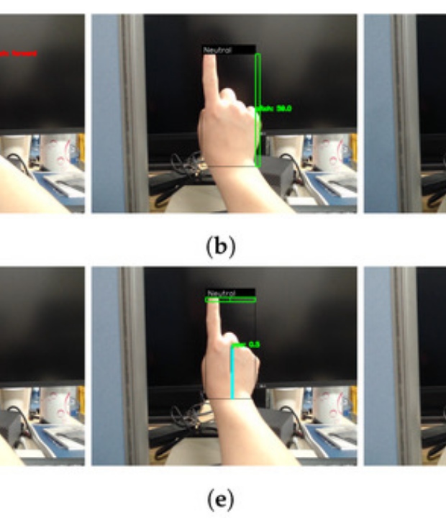
Real-Time Sign Translation
Camera Inference
The trained .keras artifact integrates seamlessly into real-time OpenCV capture loops. Incoming video feeds are preprocessed and batched at 30+ frames per second.
This bridges vital communication gaps, translating Arabic sign expressions into text and speech for seamless accessibility in educational, medical, and public sectors.

Slide 12



Questions & Discussion
Ready to walk through model architectures, convolutional layer weights, or code deployment.

Slide 13



Image Sources
https://cs.brown.edu/courses/csci1430/2024_Spring/hw5_cnns/deepNetVis.png
Source: cs.brown.edu
https://p16-oec-general-useast5.ttcdn-us.com/tos-useast5-i-omjb5zjo8w-tx/c7b954351d244305b518250574a18a7c~tplv-fhlh96nyum-crop-webp:1042:1042.webp?dr=12190&t=555f072d&ps=933b5bde&shp=8dbd94bf&shcp=e1be8f53&idc=useast5&from=2378011839
Source: shop.tiktok.com
https://www.mdpi.com/applsci/applsci-14-10230/article_deploy/html/images/applsci-14-10230-g006-550.jpg
Source: www.mdpi.com

